Slide 1
Recipe MATCHING
Alex Dolia
Deep Intellect Ltd

Slide 2
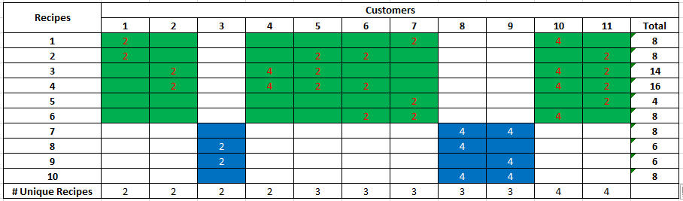
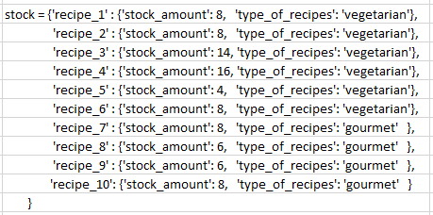
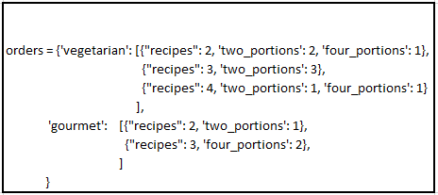
EXAMPLE OF ORDER DISTRIBUTION, Part I
The values in Blue and Green cells are the number of recipe portions.
In this example the stock contains the order without reserves.

Slide 3
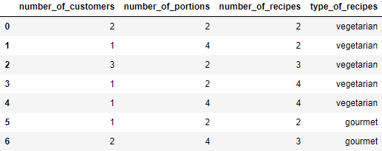
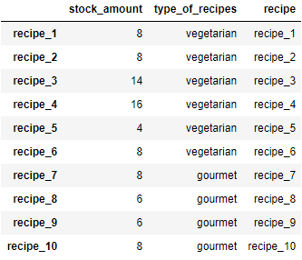
EXAMPLE OF ORDER DISTRIBUTION, Part II
Orders_df
Stock_df
Example of Orders and Stock using DataFrame

Slide 4
MAIN ALGORITHM
Sort orders_df using "type_of_recipes", "number_of_portions“ and "number_of_recipes“ in descending order.
For every row of sorted orders_df apply Recipes Matching Algorithm (see next two slides):
At the beginning we look at the Vegetarian recipes in both the order and the stock;
Then we look at Gourmet recipes in order and in the all remaining recipes in the stock.
Output is TRUE if we fulfil the order for every row of order_df and FALSE otherwise.

Slide 5
Recipes Matching Algorithm
Inputs: stock_amount,
number_of_customers,
number_of_portions,
number_of_recipes
processed_number_of_customers = 0
while processed_number_of_customers < number_of_customers perform the following:
1) Select number_of_recipes recipes in stock with number_of_recipes largest stock amount available;
2) Find the number of customers that we can fulfil the order given the number of portions and recipes obtained in Step 1, min_number_of_customers;
3) If min_number_of_customers == 0 then we cannot fulfil order and EXIT
else GOTO 4);
4) Subtract min_number_of_customers * number_of_portions from the stock for recipes obtained in Step 1.
5) processed_number_of_customers += min_number_of_customers.

Slide 6
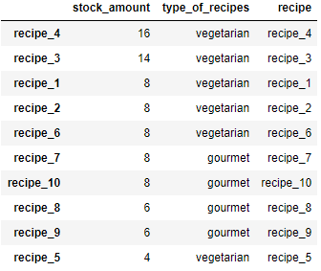
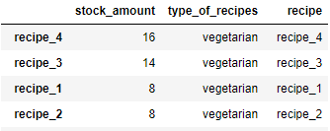


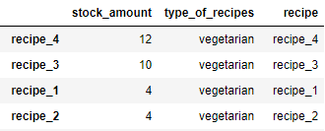
Recipes Matching Algorithm EXAMPLE
Stock sorted by stock_amount
Select number_of_recipes top stock rows
min_number_of_customers = Min([16 // number_of_portions,
14 // number_of_portions,
8// number_of_portions,
8// number_of_portions,
number_of_customers]) = 1
Subtract the following values from stock_amount:
min_number_of_customers * number_of_portions.

Slide 7
MODEL DEPLOYMENT
Develop WEB API using FLASK in Python;
Make Docker Image;
Create instance of Docker Image – Container;
Run Container.
If we want to run a cluster not a single node then we use Kubernetes pods—scheduling units that can contain one or more containers in the Kubernetes ecosystem—are distributed among nodes to provide high availability.
Any containers in the same pod will share the same resources and local network.
We can deploy the model using AWS SageMaker.

Slide 8
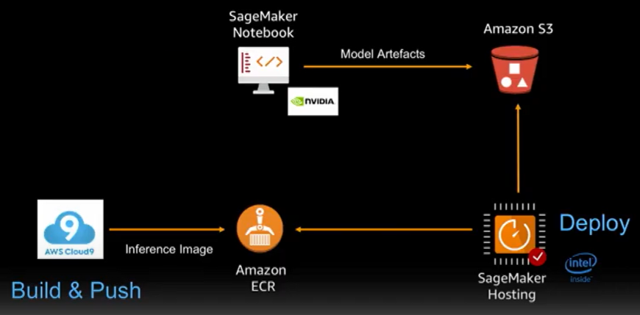
MODEL DEPLOYMENT with SageMaker AWS
Use SageMaker Notebook;
Upload Model Artifact based on isMatchingOrder to Amazon S3;
Build your own Inference Docker Image using AWS Cloud9 and push to Private Docker Repository;
Ready to use SageMaker hosting service using Model Artifact and Inference docker Image and ready to deploy;

Slide 9
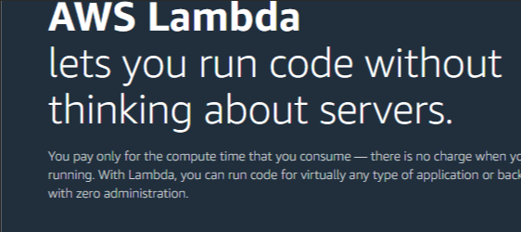
AWS Lambda
In general, a Lambda function is an example of a 'Function as a Service'. It lets you perform actions in response to certain events, called triggers. Essentially, you get to describe some events that you care about, and when those events occur, your code is executed;
For example, you could set up a trigger so that whenever data is uploaded to a particular S3 bucket, a Lambda function is executed to process that data and insert it into a database somewhere;
One of the big advantages to Lambda functions is that since the amount of code that can be contained in a Lambda function is relatively small, you are only charged for the number of executions.

Slide 10
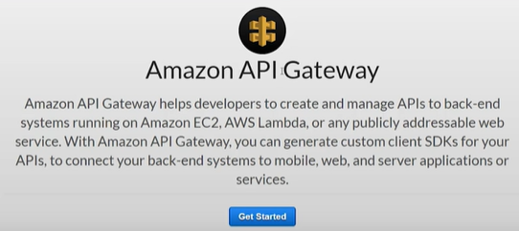
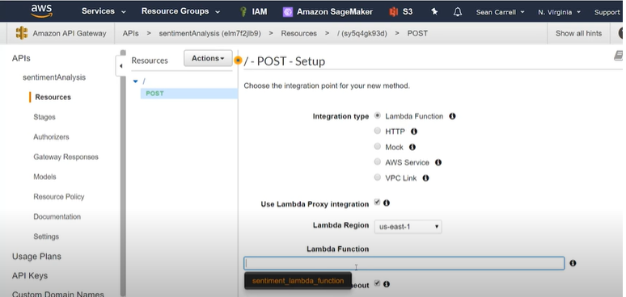
BUILDING an API
Need to create an end point or an interface that our web app can use in order to send data to our Lambda function using API Gateway

Slide 11
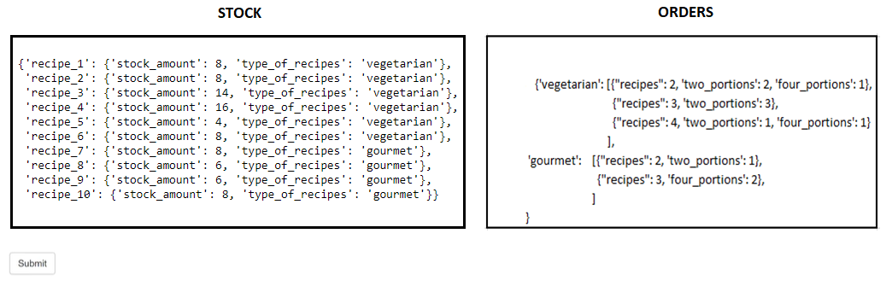
WEB PAGE EXAMPLE
After we press Submit button we get the answer TRUE or FALSE
We can modify the WEB page and select names of the files for the stock and orders data instead of Edit window.

Slide 12
CONCLUSIONS and FUTURE WORK
Developed NOTEBOOK Python code to check Order fulfilment given the stock
Made Powe Point presentation and provided the intuitive example of model performance
Discussed Deployment of the model using Docker, Kubernetes and AWS SageMaker
The algorithm can be updated for fulfilment of the order for a given customer.

